Slide 1

Netflix India YouTube Channel Analysis
A minimal presentation showcasing content performance, engagement, and channel insights
Presented By : BISWAJIT SASMAL
DATE : 04-08-2026

Slide 2

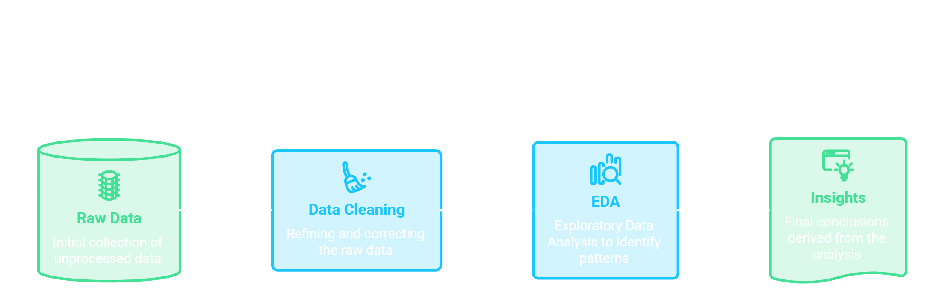
Project Objective
Identify the key factors driving YouTube video performance on Netflix India's channel and translate the findings into actionable content strategy recommendations.
To See Full Data Cleaning & EDA for Research Questions Analysis :
GitHub Repository Link

Slide 3
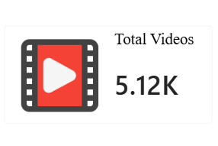
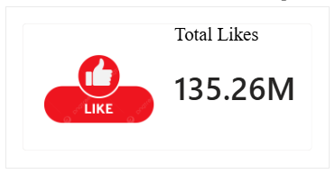
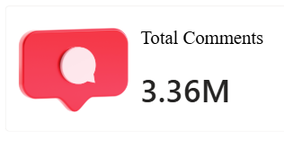
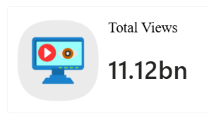
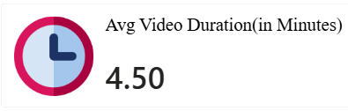
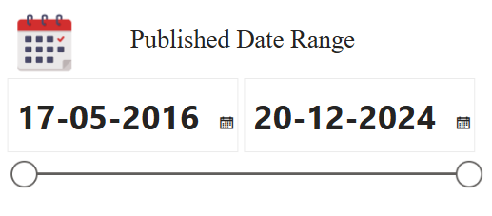
Dataset Overview

Slide 4
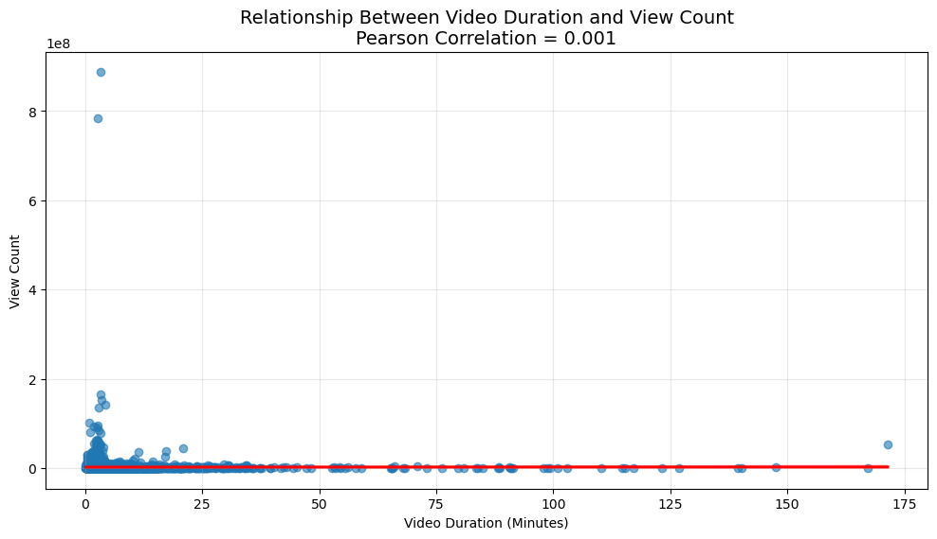
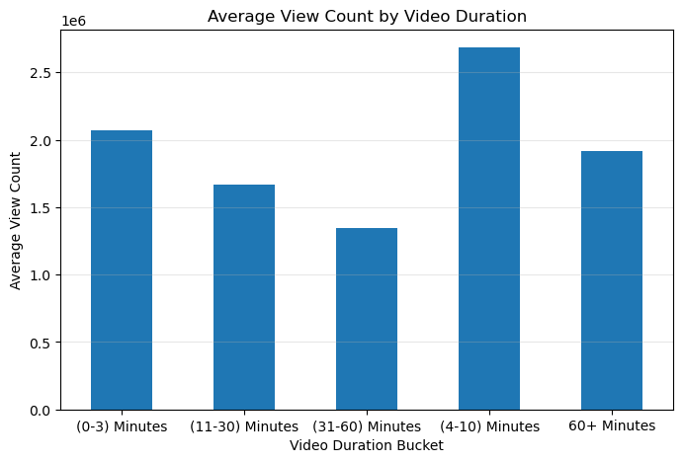
Research Question 1
Does the duration of the video influence the views and comments?
💡Key Findings & Business Insights 💡
1). Although the overall relationship is negligible, videos between 4 and 10 minutes achieve the highest average view count (2.68 million views), followed by videos between 0 and 3 minutes (2.07 million views).
2).This indicates that short to medium-length videos tend to attract more viewers than longer videos on the Netflix India YouTube channel.

Slide 5
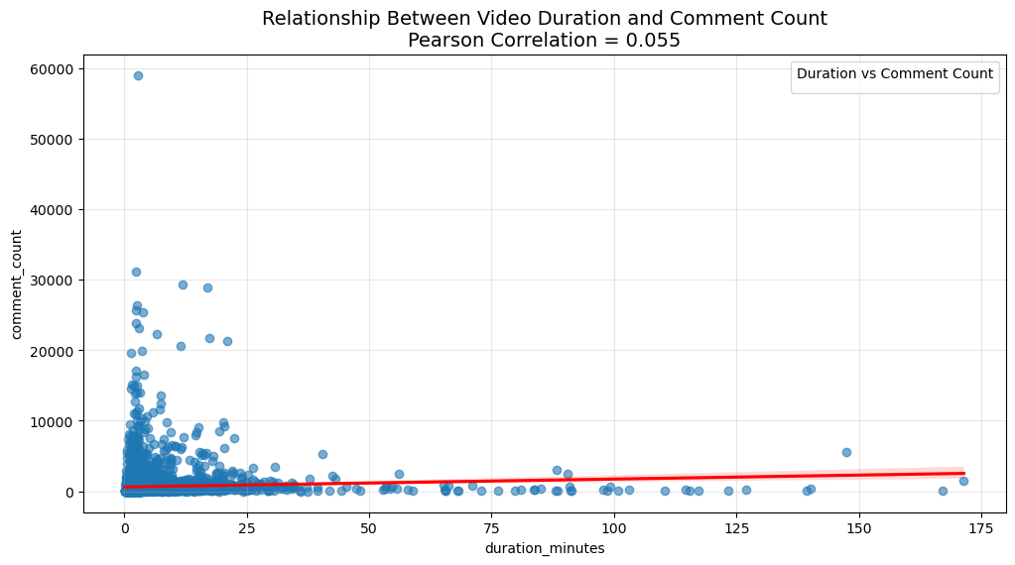
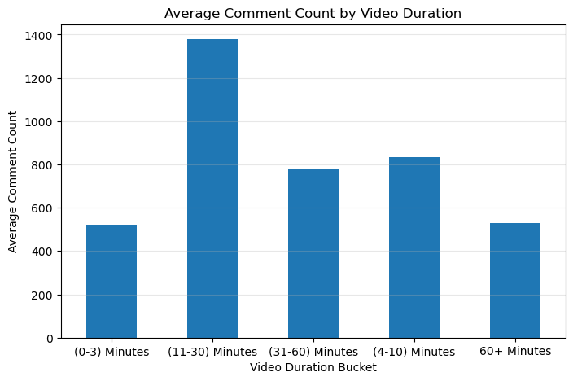
Video Duration and Comment Count Analysis
💡Key Findings & Business Insights 💡
Despite the weak overall relationship, videos with a duration of 11-30 minutes received the highest average number of comments (1,379 comments per video), outperforming both shorter and longer videos , suggesting that medium-length content may encourage relatively more audience discussion.

Slide 6
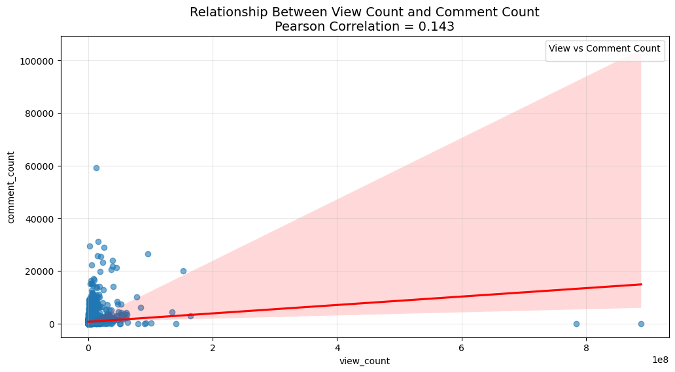
Research Question 2
Is there a relation between the views and comments?
💡Key Findings & Business Insights 💡
A weak positive correlation (r = 0.143) was observed between view count and comment count, indicating that videos with higher view counts tend to receive slightly more comments. However, the relationship is weak, suggesting that audience discussion is influenced by factors beyond the number of views, such as content type, emotional appeal, audience engagement, and the nature of the video.

Slide 7
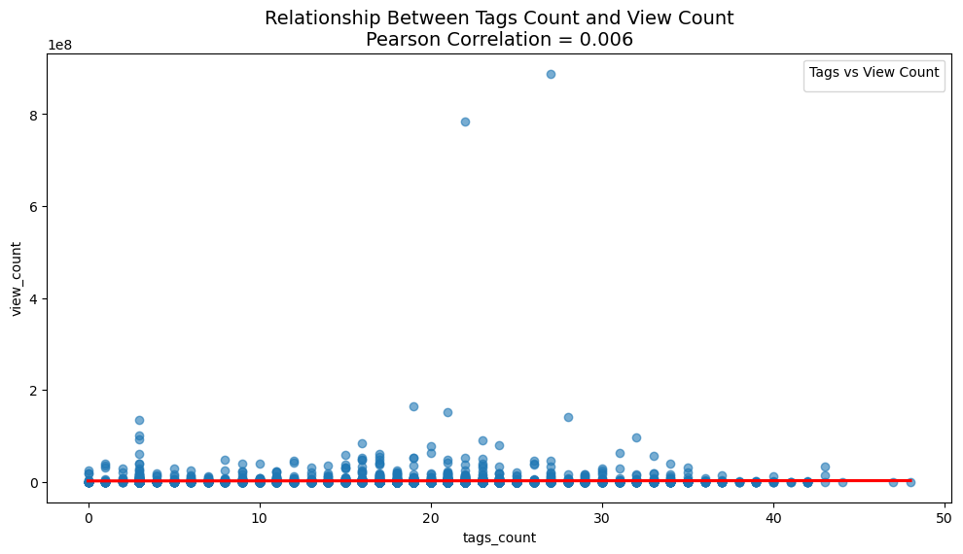
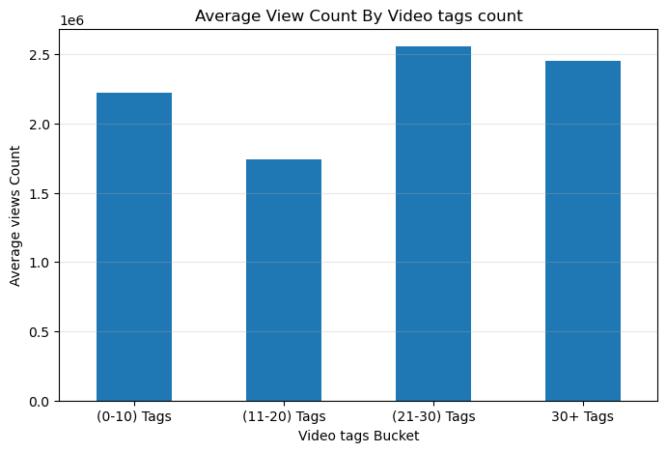
Research Question 3
Does tag count matter to get more views?
💡Key Findings & Business Insights 💡
Tag count does not appear to have a meaningful influence on video views. The Pearson correlation coefficient between tag count and view count is 0.006, indicating virtually no linear relationship. Although videos with 21-30 tags recorded the highest average view count (2.56 million), the differences across tag buckets are inconsistent, suggesting that simply adding more tags does not guarantee higher viewership.

Slide 8
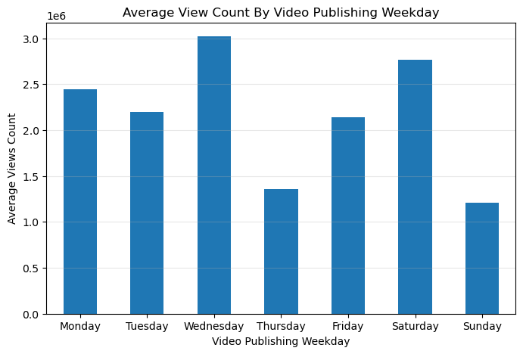
Research Question 4
Does video publishing day or time influence the engagement?
💡Key Findings & Business Insights 💡
Yes , Video Publishing Day Influence video engagement and views Count.
Videos Published in Wednesday got more views and engagement followed by Saturday and Monday on an average.

Slide 9
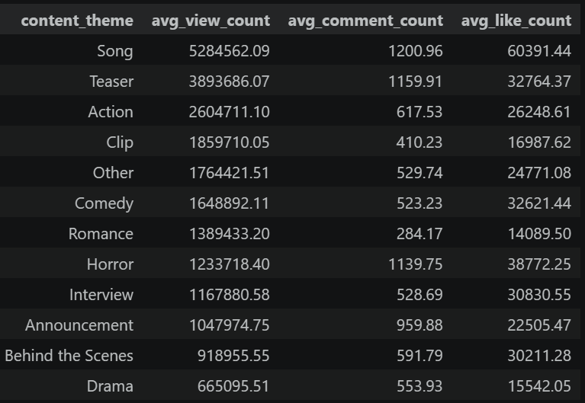
Research Question 5
Are there certain topics or themes that consistently perform better than others?
💡Key Findings & Business Insights 💡
The analysis shows that video performance varies considerably across content themes. Song videos are the highest-performing category, followed by Teasers, both generating substantially higher average views, likes, and comments than most other themes. In contrast, categories such as Drama and Behind the Scenes attract comparatively lower audience engagement. These findings suggest that content theme is an important factor influencing video performance, with promotional and music-related content consistently outperforming many other formats on the Netflix India YouTube channel.

Slide 10
Research Question 6
Are there any videos that have no tags, but performed well?
Ghoul: The Room | Official [VR] | Netflix
Ghoul - Silent Trailer I Netflix I HD
1.8Cr Views
41.1K Likes
1.8K Comments
1.8 Cr Views
40.1K Likes
2.3K Comments
Heating Up | Netflix
2.4Cr Views
26.6K Likes
2.4K Comments

Slide 11
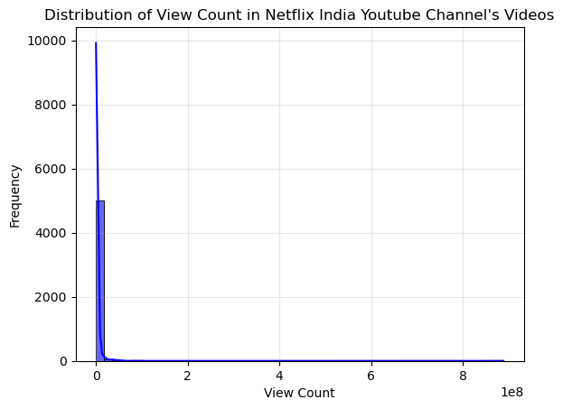
Research Question 7
What is Video views distribution (consider all the videos) in Netflix India YouTube Channel?
💡Key Findings & Business Insights 💡
The analysis shows that view counts on the Netflix India YouTube channel are highly concentrated among a small number of viral videos. The distribution is extremely right-skewed (skewness = 39.58), with the average view count (2.17 million) being much higher than the median (221,081). Furthermore, 75% of videos receive fewer than 937,317 views, indicating that only a limited number of videos achieve exceptionally high reach.

Slide 12
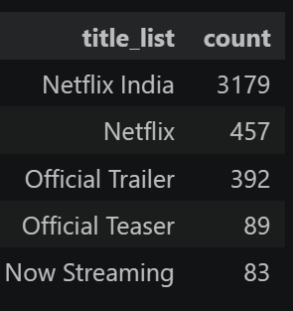
Research Question 8
What is the most used keyword in YT titles?
💡Key Findings & Business Insights 💡
70.94% of Netflix India’s videos use either “Netflix India” (62.04%) or “Netflix” (8.9%) in their titles, indicating a strong and consistent brand-focused titling strategy.
Among content-related keywords, 'Official Trailer' is used most frequently, highlighting trailers as the channel's dominant promotional format. In contrast, keywords such as 'Official Teaser' and 'Now Streaming' are used less often, suggesting they play a supporting role in the overall content strategy.

Slide 13
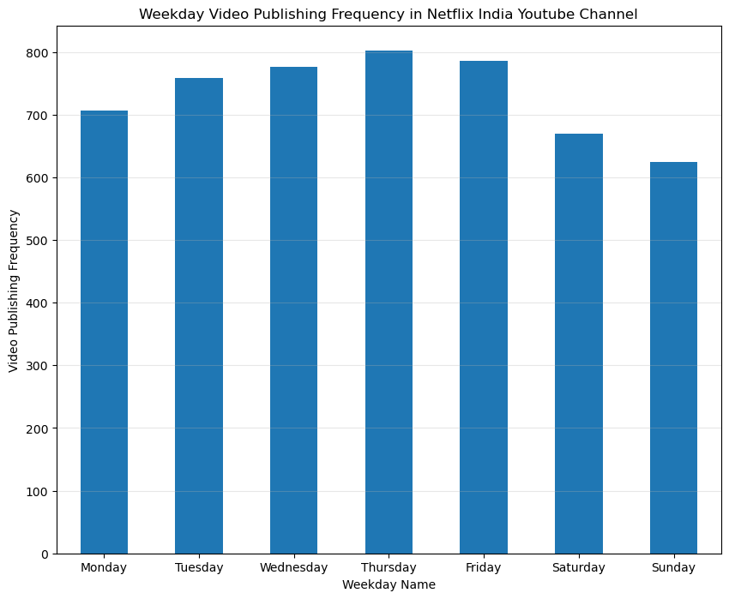
Research Question 9
What is the frequency of video publishing by weekday?
💡Key Findings & Business Insights 💡
Netflix India follows a consistent weekly video publishing strategy, releasing content across all seven days of the week. Although videos are uploaded throughout the week, Thursday records the highest publishing frequency, while Sunday has the fewest uploads. The relatively small differences between weekdays indicate that the channel prioritizes maintaining a steady flow of content rather than relying on a single publishing day.

Slide 14
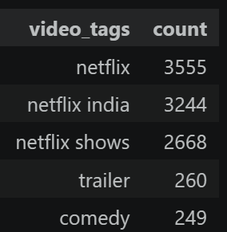
Research Question 10
What are the keywords Netflix used the most in their YouTube Video tags?
💡Key Findings & Business Insights 💡
Netflix India primarily uses brand-focused tags such as ‘#netflix', ‘#netflix india', and ‘#netflix shows' to strengthen brand identity and improve content discoverability. Among descriptive content tags, 'trailer' is the most commonly used, highlighting promotional content as a major part of the channel's publishing strategy. The presence of genre-specific tags like 'comedy' also indicates an effort to improve discoverability for audiences interested in specific types of content.

Slide 15
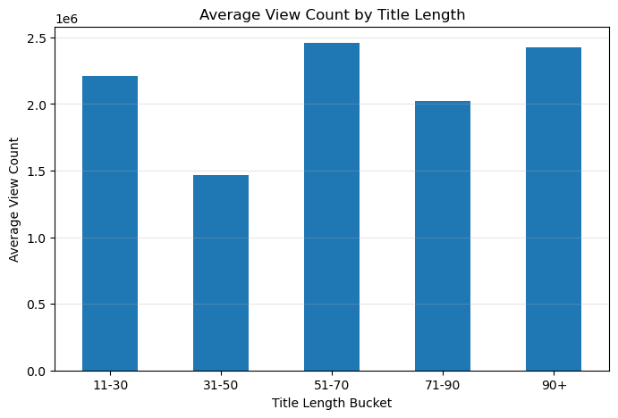
Research Question 11
Does title length influence views?
💡Key Findings & Business Insights 💡
The analysis found virtually no relationship between title length and video views (Pearson's r = 0.004). Although videos with titles between 51 and 70 characters recorded the highest average view count, the differences across title-length buckets were inconsistent. This suggests that title length alone is not a reliable driver of video performance, and other factors such as content relevance, thumbnails, and audience interest are likely to play a more significant role in attracting viewers.

Slide 16
Strategic Recommendation
🎬 Prioritize High-Performing Content Themes Focus more on content themes that consistently generate higher views and engagement
📝 Optimize Video Titles Use proven, high-performing keywords in concise titles while maintaining strong brand visibility.
📅 Optimize Publishing Schedule Prioritize the weekdays and publishing periods associated with stronger video performance.
4. 🏷️ Use Tags Strategically, Not Excessively Maintain relevant tags for discoverability, but focus more on content quality, topic relevance, and strong titles than simply increasing tag count.
5. ⏱️ Focus on Content Value Over Video Length Avoid assuming longer videos perform better. Optimize duration based on the content type and audience value rather than targeting a fixed length.

Slide 17




Thank You
BISWAJIT SASMAL
Aspiring Data Analyst
Connect With Me

